Slide 1

Basic Details of the Team and Problem Statement
Ministry/Organization Name/Student Innovation:
AICTE,MIC-Student Innovation
PS Code: 1468
Problem Statement Title: Student Innovation
Team Name: Tech Renegades
Team Leader Name: Shaikh Muhammadumar
Institute Code (AISHE): U-0136
Institute Name: Department Of Computer Science
Theme Name: Disaster Management

Slide 2
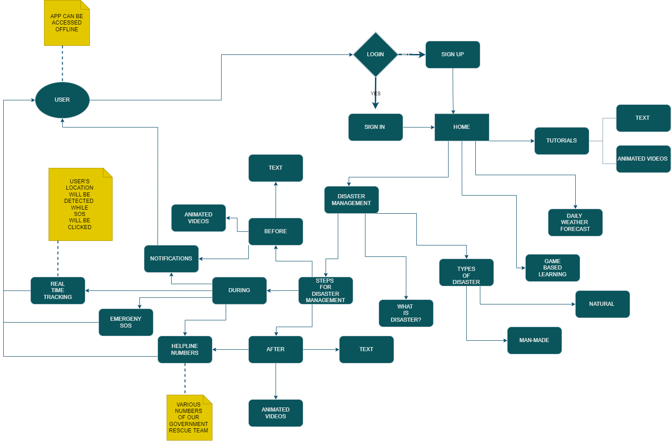

Idea/Approach Details
Describe your idea/Solution/Prototype here:
Our solution for disaster management is to develop provide information and assistance during natural or man-made disasters.
The app will show preventive measures to be taken before the disaster, during the disaster and after the disaster in the form of text ,visual animations and games.
The app will notify the users about the upcoming disasters that are going to occur in their areas and will guide the users.
Describe your Technology stack here:

Slide 3
Idea/Approach Details
Describe your Use Cases here
Describe your Show stopper here
Highly prone areas: The areas where occurrence of disasters is more.
Educational purpose: Details of different disasters are provided.
Offline access: It will also work efficiently in areas where low network is there or no network is there.
Weather forecasting: The app will show details about the weather in the respective areas.
Disaster alerts and notification: The app notify the person about the occurrence of the disaster.
Real time tracking: It will help user to know about the disaster that is going to occur in their state or in any other state.
Emergency tools: Siren and flash light of phone will start as soon as the person get stuck in any disaster and clicks on emergency SOS button.
Notifications and live location: User will get notify about the occurring disaster. Live location of the user will be shared to all the relatives of the user.
Cross device support: Works perfectly for all devices like android and IOS.

Slide 4
Team Member Details
Team Leader Name: Shaikh Muhammadumar
Branch: 5 yr Int. M.Sc Stream: CS Year: II
Team Member 1 Name: Keswani Palak
Branch: 5 yr Int. M.Sc Stream: CS Year: II
Team Member 2 Name: Saheta Diya
Branch: 5 yr Int. M.Sc Stream: CS Year: II
Team Member 3 Name: Makwana Dev
Branch: 5 yr Int. M.Sc Stream: CS Year: II
Team Member 4 Name: Rupavatiya Prince
Branch: 5 yr Int. M.Sc Stream: CS Year: II
Team Member 5 Name: Jariwala Mohit
Branch: 5 yr Int. M.Sc Stream: CS Year: II

Slide 5
Important Pointers
Please ensure below pointers are met while
Kindly keep the maximum slides limit to 4 pages
All the topics should be utilized for description of your idea
Try to avoid paragraphs and post your idea in points
Keep your explanation precisely and easy to understand
Idea should be unique and novel. If it has a business potential more weightage will be given.
Apart from this PPT abstract of your idea will be asked separately while submitting
You need to save the file in PDF and upload the same on portal. No PPT, Word Doc or any other format will be supported
You can delete this slide (Important Pointers) when you upload the details of your idea on SIH portal.

